Slide 1



Movie Recommender System
CHINMAYEE MAKARAJU – 1002091569
AJAY DODKE – 1002073040
SINDHURA RAMA – 1002059207
DASC5302 – 001
CAPSTONE SPRING 24
GROUP 30

Slide 2

Agenda
Abstract
Introduction
Problem Statement
Proposed Methodology
Analysis
Exploratory Data Analysis
Similarity Techniques
Surprise Library Models Evaluation
Feature Importance
Summary

Slide 3


Abstract
Our project proposes a Movie Recommender System utilizing collaborative filtering and matrix factorization techniques. Leveraging a Netflix dataset with millions of ratings from users, our system aims to combat choice overload by offering personalized movie recommendations. By analyzing user behaviors, our system enhances satisfaction, streamlines decision-making, and potentially boosts business revenue through improved conversion and retention rates. Committed to thorough research and implementation, we aim to deliver an adaptive and effective recommendation system for enriching the movie-watching experience.

Slide 4

Introduction
Content streaming platforms have transformed media consumption but introduced choice overload.
Project goal: Develop a sophisticated Movie Recommender System to combat choice overload by leveraging user data.
Approach: Utilize collaborative filtering techniques to analyze user-generated data and identify meaningful patterns.
Algorithm focus: Explore matrix factorization to develop accurate algorithms for predicting user preferences and enhancing the viewing experience.

Slide 5

Problem Statement
Users experience overwhelming options on content streaming platforms, leading to decision fatigue and dissatisfaction.
Generic recommendations and browsing by genres fail to cater to individual preferences and viewing habits.
Users struggle to discover new content they would enjoy, resulting in missed opportunities for a satisfying viewing experience.
There is a pressing need for a solution that addresses choice overload by providing personalized movie recommendations to enhance user satisfaction and engagement.

Slide 6
Proposed Methodology
Collaborative Filtering Techniques:
Utilize collaborative filtering to analyze user interactions and preferences.
Identify patterns and similarities among users with similar tastes.
Leverage a dataset sourced from Netflix with millions of user ratings and reviews.
User-Based Collaborative Filtering:
Identify users with similar movie preferences based on their ratings.
Recommend movies highly rated by similar users but not yet watched by the target user.
Item-based Collaborative Filtering:
Recommend movies similar to those the user has already enjoyed.
Based on similarities in ratings and reviews from other users.
Content-Based Filtering:
Analyze attributes and features of movies (e.g., genre, actors, directors, plot keywords).
Recommend similar movies based on attributes of movies the user has previously enjoyed.

Slide 7
Proposed Methodology
Hybrid Recommender System:
Combine collaborative filtering and content-based filtering approaches.
Leverage both user interactions and movie attributes for more accurate and diverse recommendations.
Advanced Statistical Methods:
Implement matrix factorization techniques to enhance system performance.
Improve the accuracy of predictions by leveraging advanced statistical methods.
Experimentation and Evaluation:
Conduct rigorous experimentation and evaluation of the recommender system.
Ensure the system is capable of alleviating choice overload and enhancing the movie-watching experience.
Sophisticated Recommender System:
Aim to develop a sophisticated movie recommender system.
Capable of delivering personalized recommendations and improving user satisfaction.

Slide 8
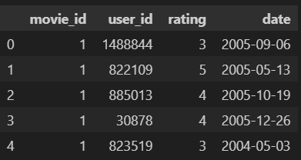
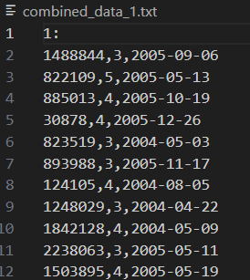

Analysis
1. We imported our dataset from Kaggle in the format shown in 4 different text files.
2. We then converted the data set into pandas using pandas Data frames.
3. The statistics obtained are displayed here.

Slide 9
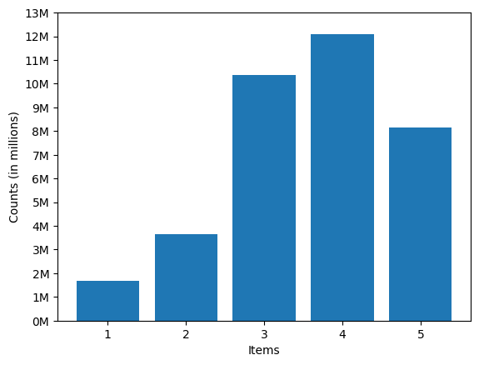
Exploratory Data Analysis
Histogram Analysis of Movie Ratings Distribution
Peak: Highest count at rating 4, slightly above 12 million movies.
Overall Trend: Lower counts for ratings 1 and 5, more common for ratings 2, 3, and 4.
Favorable Ratings: The dataset favors moderate ratings (3 and 4) with fewer extreme ratings (1 and 5).

Slide 10
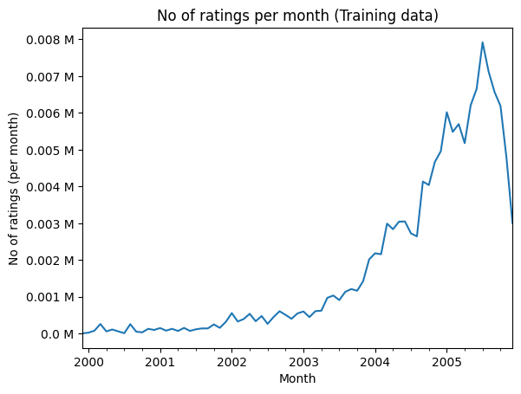
Exploratory Data Analysis
Number of Ratings per Month (Line Graph)
Upward Trend: Sharp increase in ratings after 2003, with notable spikes toward the end of the timeline.
Growth Pattern: The dataset experienced substantial growth in ratings from 2000 to 2005.

Slide 11
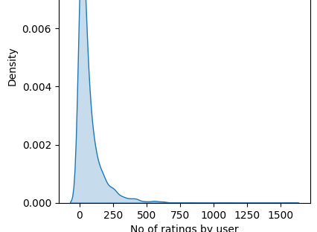
Exploratory Data Analysis
Probability Density Function (PDF) of User Ratings
X-Axis: Number of ratings given by users.
Y-Axis (Density): Likelihood of a specific number of ratings.
Peak Density: Near zero ratings, indicating many users give very few ratings.
Density Trend: Decreases gradually as the number of ratings increases.
Interpretation: Most users rate only a few items, while fewer users give more ratings.

Slide 12
Similarity Techniques
Movie-movie similarity matrix was computed due to computational limitations with user-user similarity for 400k users with 17k-dimensional vectors.
Cosine Similarity Technique:
Utilized cosine similarity to measure similarity between movie vectors.
Computes the cosine of the angle between vectors, indicating similarity based on distance.
Pros | Cons
Straightforward and easy-to-understand technique. Computationally efficient for generating recommendations once the similarity matrix is computed. | Limited in capturing individual user preferences and tastes. May prioritize recommending popular or mainstream movies over a niche or less popular items

Slide 13
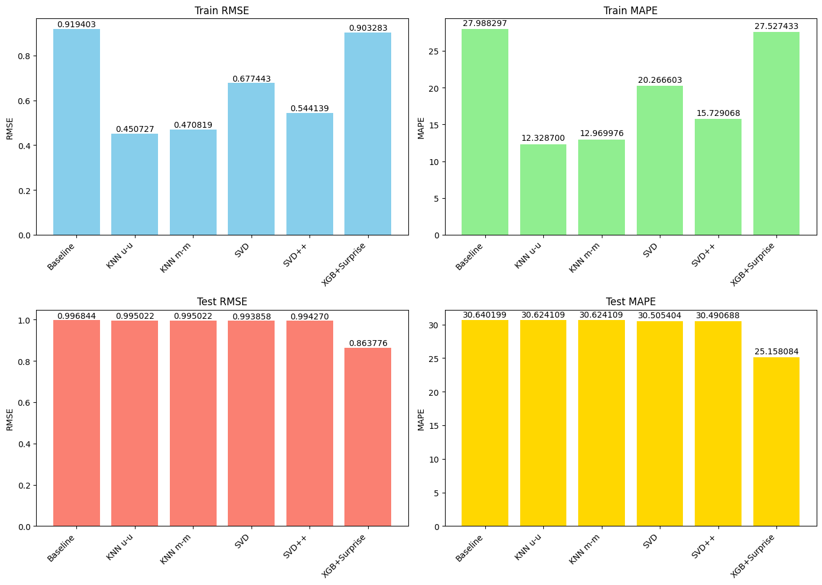
Surprise Library Models Evaluation
Evaluation Metrics Used:
->RMSE (Root Mean Square Error):
Measures average magnitude of errors between predicted and actual values.
Lower RMSE indicates better model accuracy, closer to zero is more precise.
->MAPE (Mean Absolute Percentage Error):
Measures average percentage difference between predicted and actual values.
Lower MAPE signifies better model performance, closer to zero is more accurate relative to actual values.

Slide 14
Surprise Library Models Evaluation
Baseline Models:
Baseline Model:
Performs decently but has relatively high RMSE and MAPE, indicating room for improvement.
KNN (user-user and movie-movie):
Lower RMSE and MAPE compared to baseline, suggesting collaborative filtering can improve recommendations.

Slide 15
Surprise Library Models Evaluation
Matrix Factorization Models:
SVD (Singular Value Decomposition):
Performs better than collaborative filtering, indicating the effectiveness of matrix factorization.
SVD++ (SVD with implicit feedback):
Similar performance to SVD with slightly improved results, generalizes well to test set.

Slide 16
Surprise Library Models Evaluation
Featuring Data for Hybrid Model:
Calculated global average rating for each movie and user.
Used these averages as features along with predicted ratings from baseline and matrix factorization models.
Each user-movie pair is represented as a feature vector with 8 features including predicted ratings and global averages.
Hybrid Model:
Utilized GridSearch CV for optimal parameter selection and Cross-validation checks for model optimization.
Combined features from baseline and matrix factorization models with global average ratings as an input to the XGBoost model and achieved optimal model performance through parameter tuning and validation checks.

Slide 17
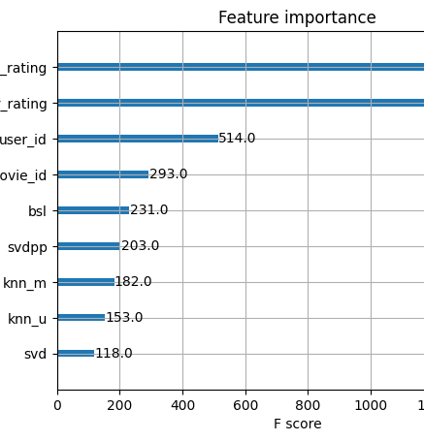
Feature Importance
XGBoost with Surprise Features:
Outperforms other models with the lowest RMSE and MAPE on train and test sets.
Incorporating machine learning models with collaborative filtering features leads to superior performance.
Feature Importance based on F1 Score:
Predicted ratings from baseline model (bsl)
Predicted ratings from user-user KNN model (knn_u)
Predicted ratings from movie-movie KNN model (knn_m)
Predicted ratings from the Singular Value Decomposition (SVD) model
Predicted ratings from the SVD++ model with implicit feedback
Global average rating for the user
Global average rating for the movie
User ID
Movie ID

Slide 18
Summary
The KNN models, SVD, SVD++, and XGBoost with Surprise features outperform the Baseline model regarding RMSE and MAPE. Among these, XGBoost with Surprise features performs best on both train and test sets, indicating its effectiveness in capturing complex patterns. Incorporating machine learning techniques like XGBoost with collaborative filtering features enhances recommendation system accuracy, showcasing the potential of hybrid approaches for personalized recommendations.

Slide 19
Thank You

